Slide 1
Peel-Yalgorup System
By Kayden Leasor

Slide 2
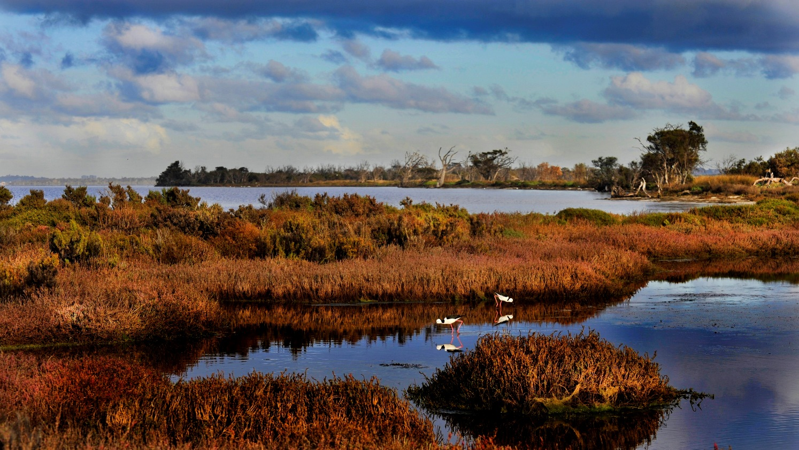
The Peel-Yalgorup system is a wetland on the South-West coast of WA
What It Is

Slide 3
Ramsar Convention
The Ramsar convention is a treaty signed by nations to conserve natural resources.
It is important because it’s helps the preservation of the wetlands.

Slide 4
Why My wetland qualifies
The wetland I’m doing qualifies for the 1st, 3rd, 5th and 6th Criterion.
It meets the first criteria because it’s a natural wetland
It meets the third criteria because It is one of the few places that have living thrombocytes in inland, hyposaline waters.
It meets the fifth criteria because it supports in excess of twenty thousand water birds annually
It meets the sixth criteria because over 1% of the world population of several waterbird species regularly use the Peel-Yalgorup for the services the wetland provides such as food, shelter, nesting and moulting sites.

Slide 5
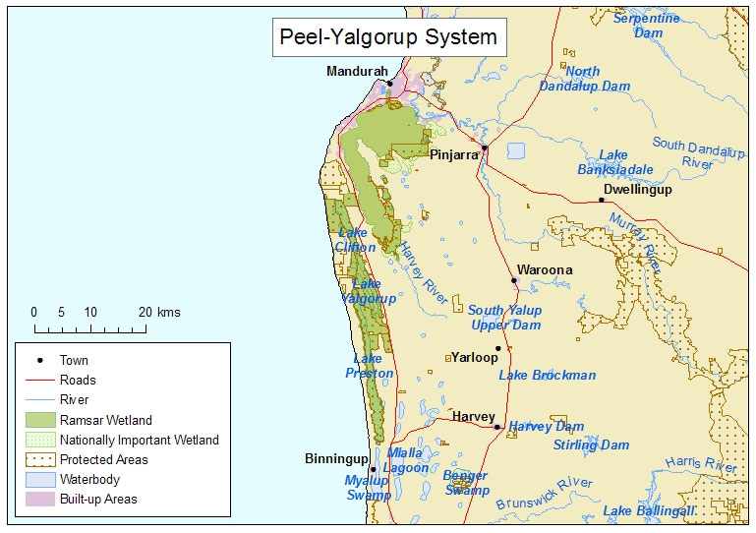
Map of the wetland site
The Geographical coordinates of the Peel-Yalgorup system are Latitude: 32°32' S to 33°06' S; Longitude: 115°37' E to 115°47' E

Slide 6
Social/Cultral Values
The Peel-Yalgorup wetland is an important fishery. The species include King George Whiting, Black Bream, Cobbler, Blue Swimmer Crabs and Western King Prawns. It is estimated that fishing operations in the wetland are worth about $1 million per annum in fish.

Slide 7
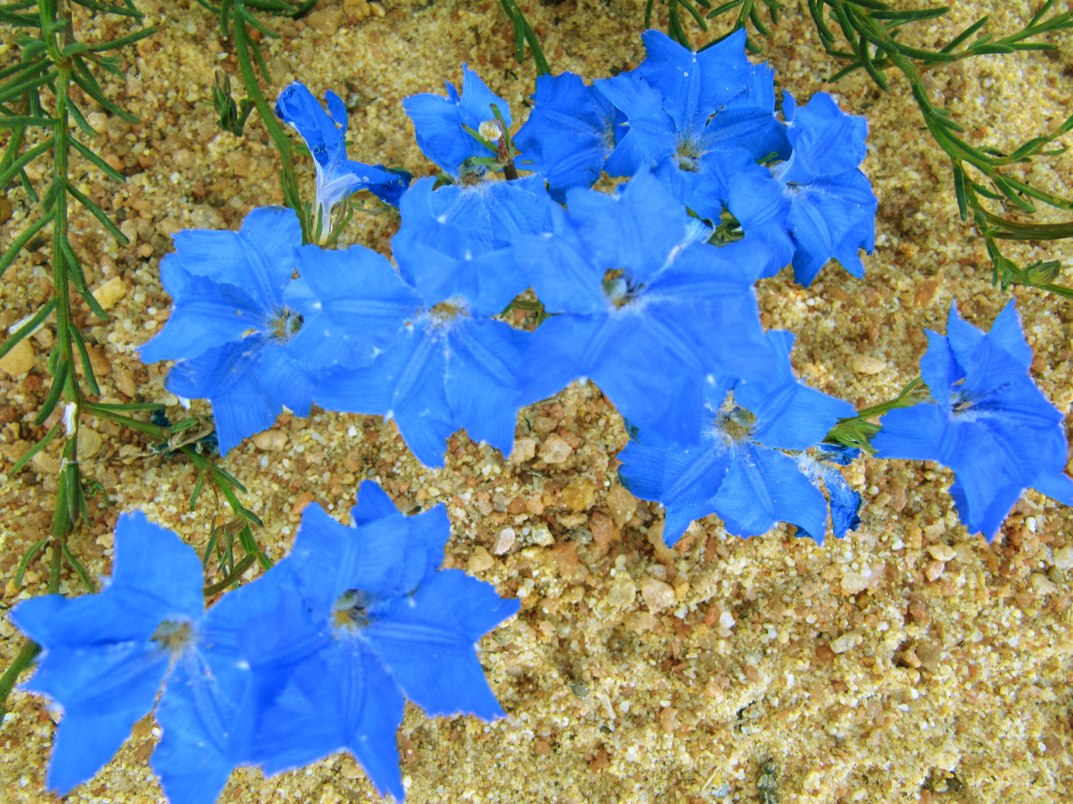
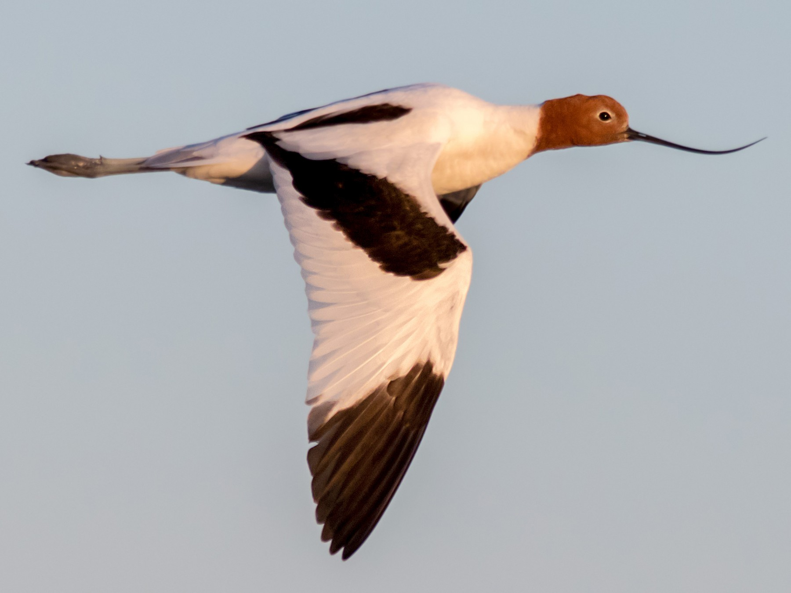
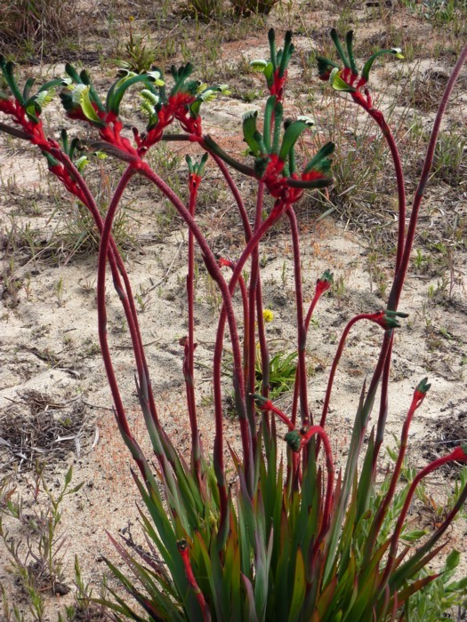
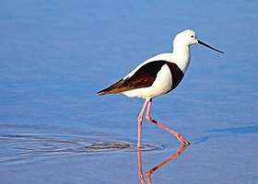
Flora & Fauna
Blue Leshenaultias
Red Necked Avocet
Red and Green Kangaroo Paws
Banded Stilt

